Slide 1

RUNGTA COLLEGE OF DENTAL SCIENCES AND RESEARCH
RHEUMATIC HEART DISEASE
DEPARTMENT OF GENERAL MEDICINE

Slide 2
SPECIFIC LEARNING OBJECTIVES
MUST KNOW | NICE TO KNOW | DESIRE TO KNOW
PATHOGENESIS | DIAGNOSIS | TYPES OF ENDOCARDITIS
CLINICAL FEATURES | CHRONIC RHEUMATIC HEART DISEASE | NONBACTERIAL THROMBOTIC ENDOCARDITIS
JONES CRITERIA | MITRAL VALVE STENOSIS | VERRUCOUS ENDOCARDITIS

Slide 3
CONTENTS
ENDOCARDITIS TYPES
RHEUMATIC HEART DISEASE
INTRODUCTION
PATHOGENESIS
PATHOLOGIC FEATURES
CLINICAL FEATURES
JONES CRITERIA
DIAGNOSIS
CHRONIC RHEUMATIC HEART DISEASE
MITRAL VALVE STENOSIS
NONBACTERIAL THROMBOTIC ENDOCARDITIS
VERRUCOUS ENDOCARDITIS
CONCLUSION

Slide 4
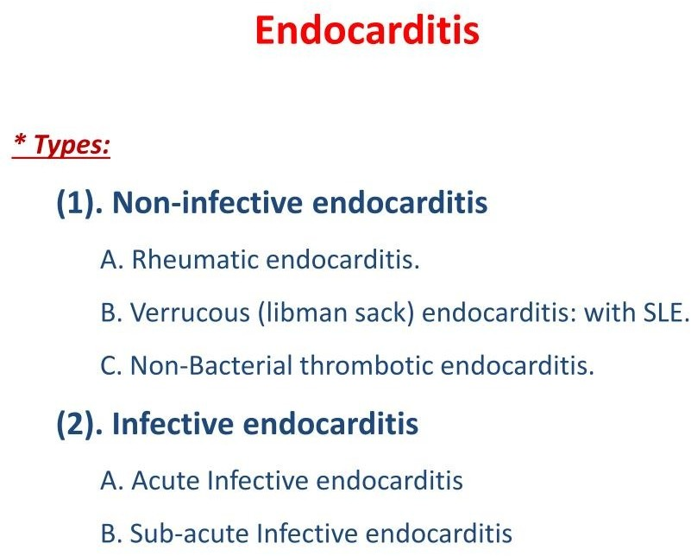

Slide 5


Slide 6
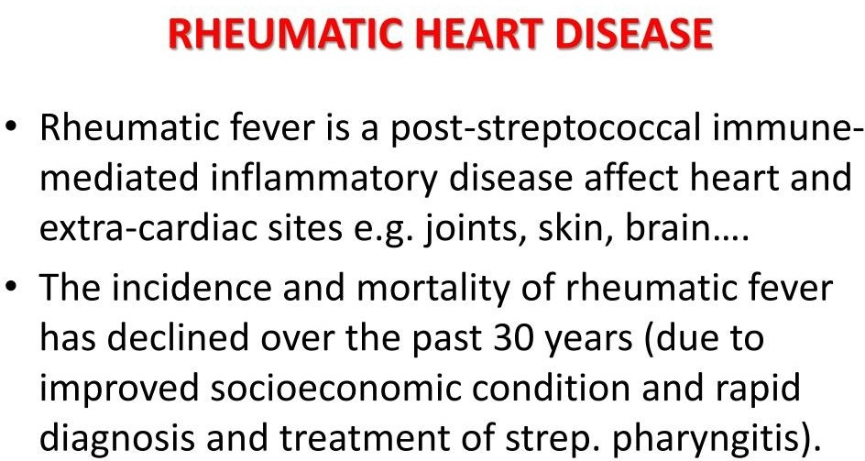

Slide 7
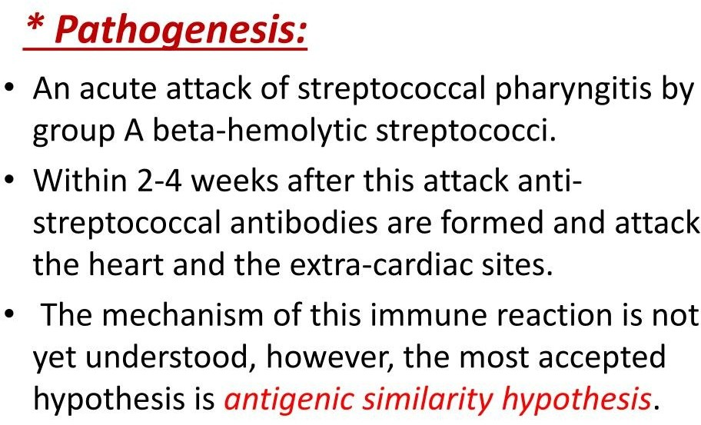

Slide 8
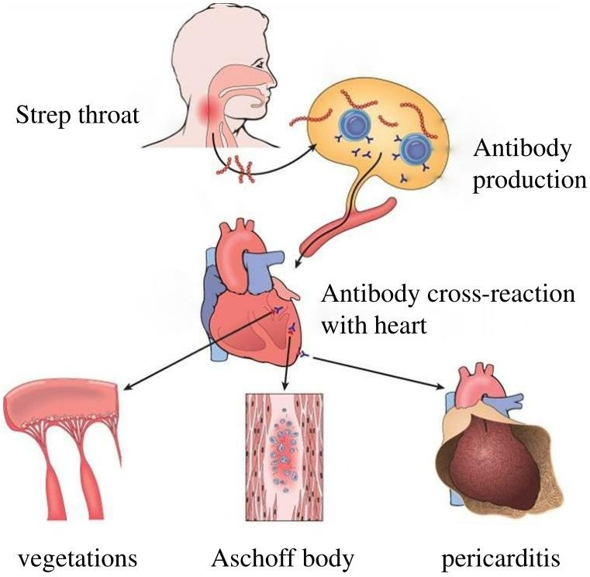

Slide 9
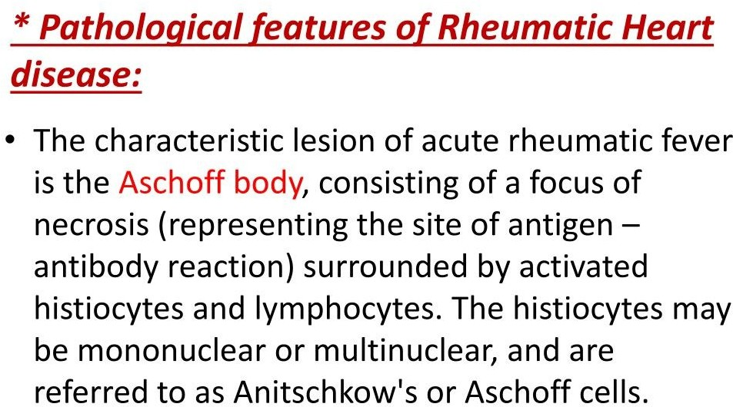

Slide 10
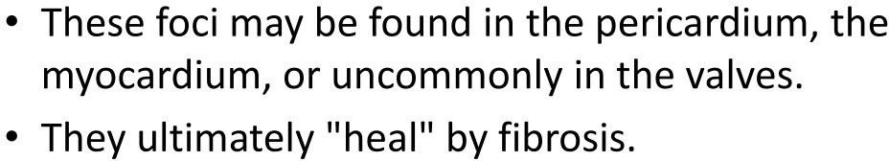

Slide 11
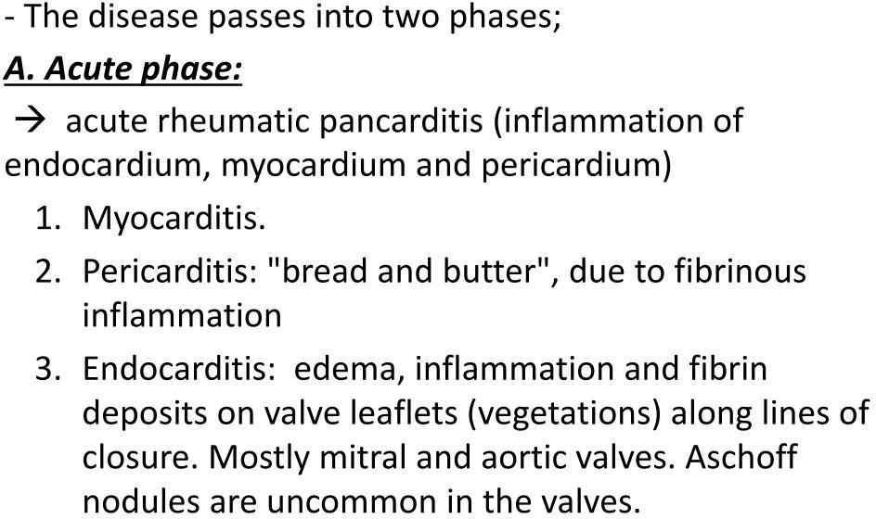

Slide 12
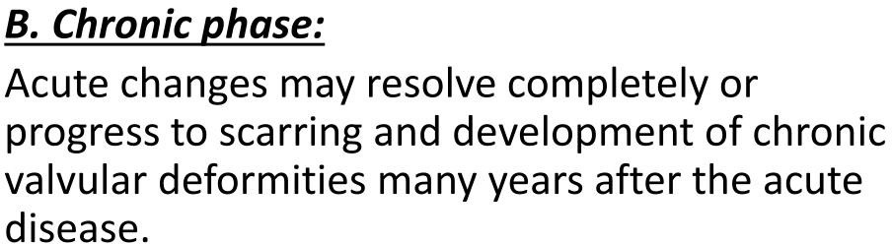

Slide 13
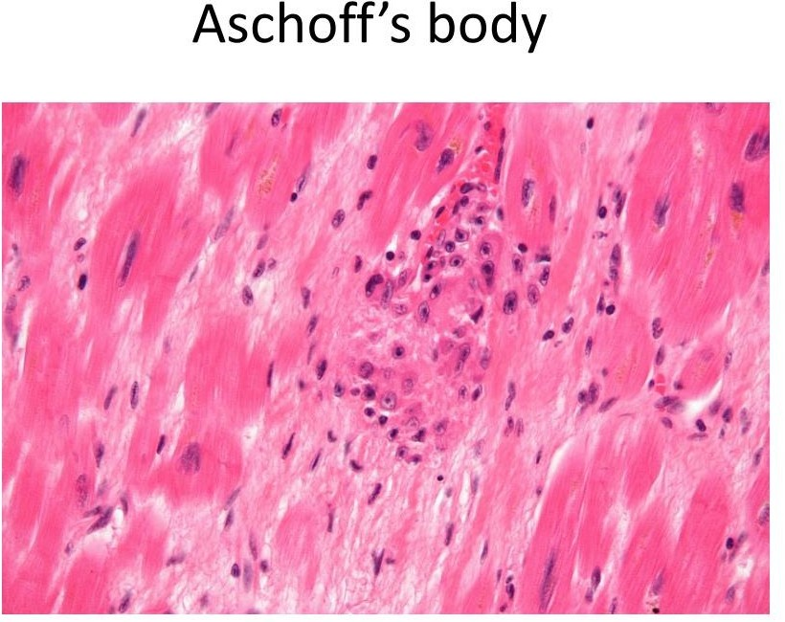

Slide 14
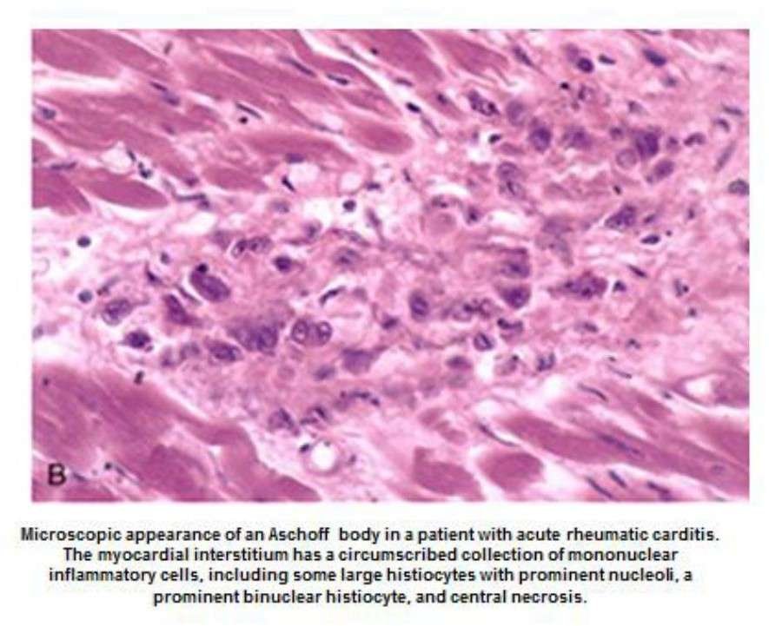

Slide 15
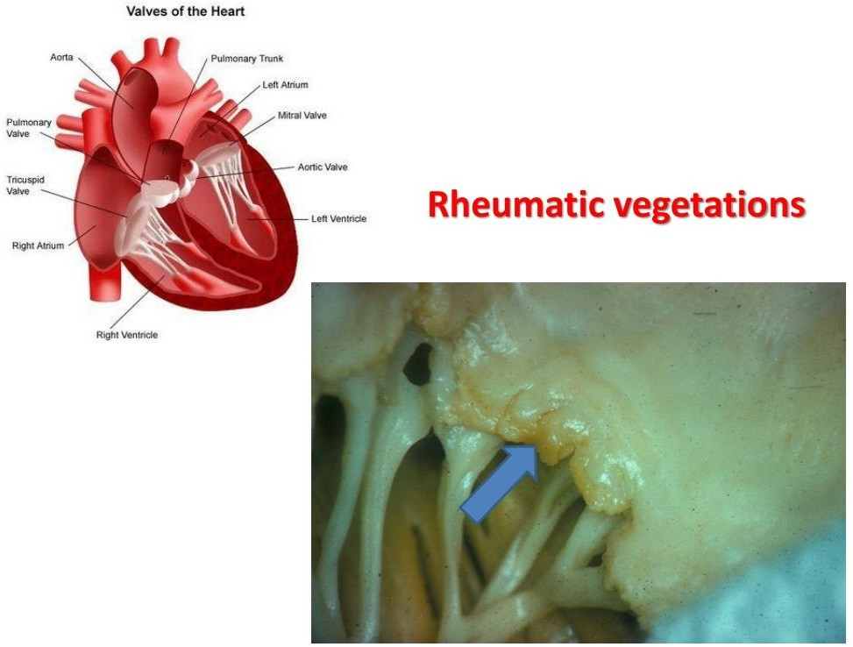

Slide 16
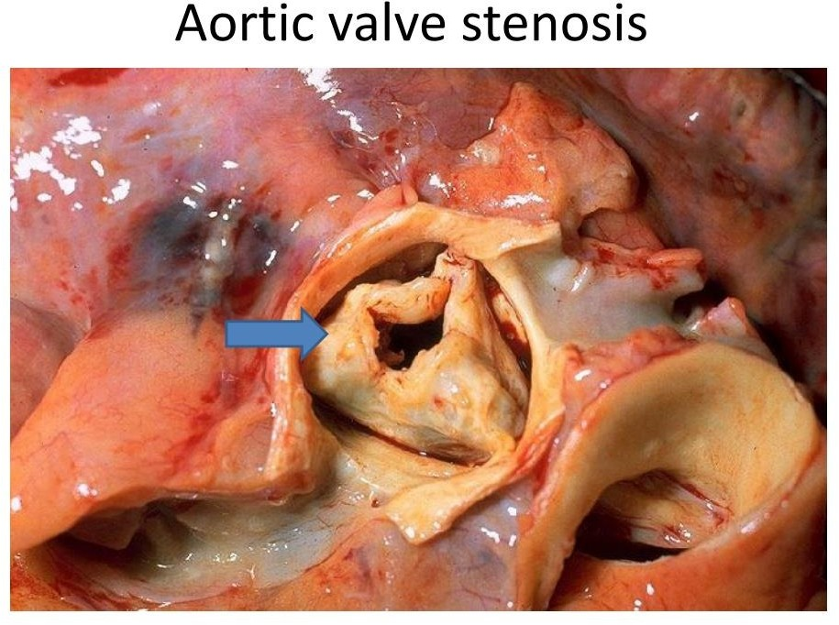

Slide 17
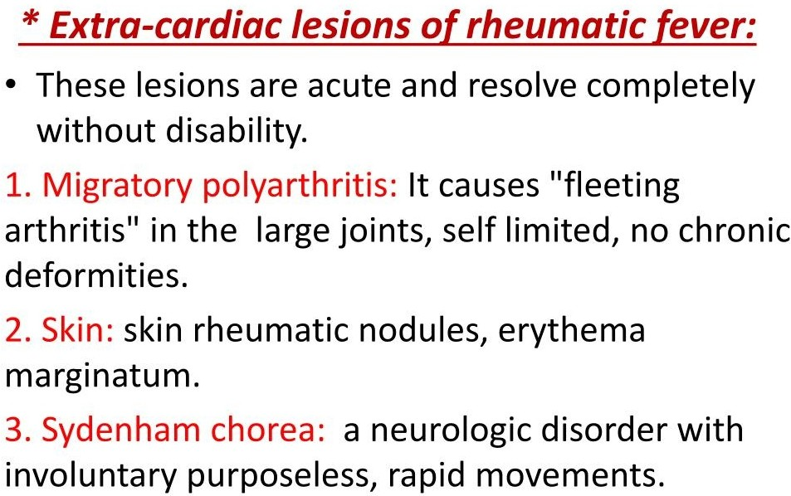

Slide 18
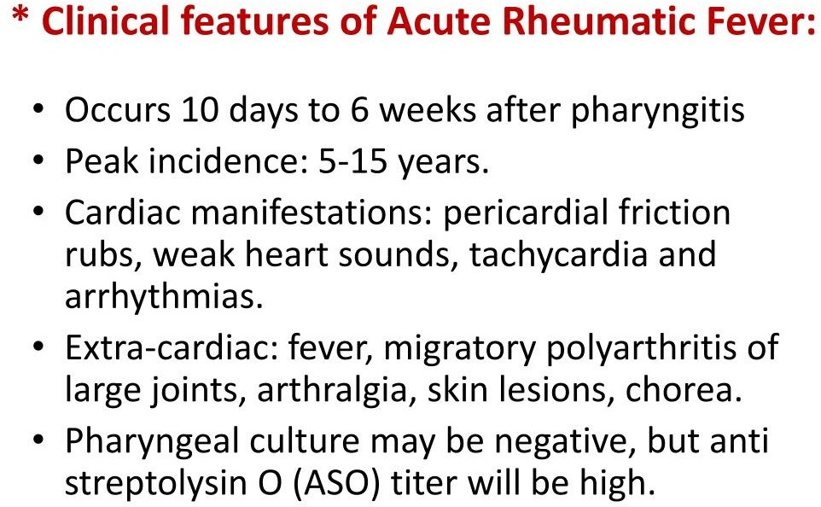

Slide 19
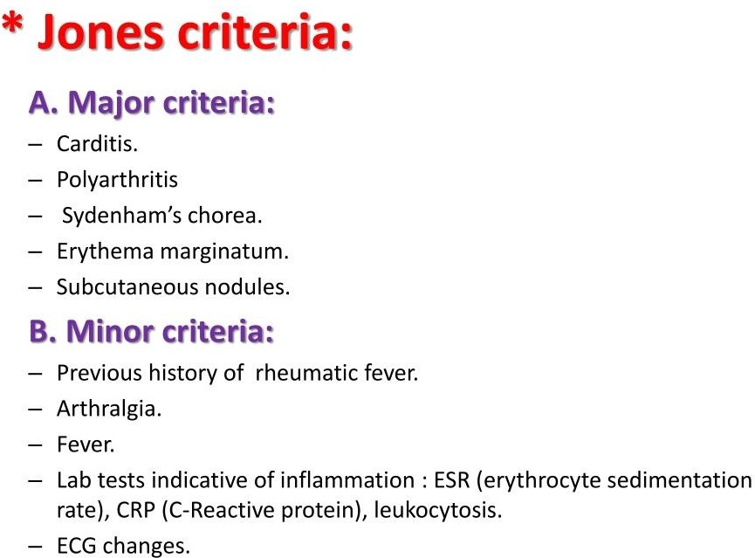

Slide 20
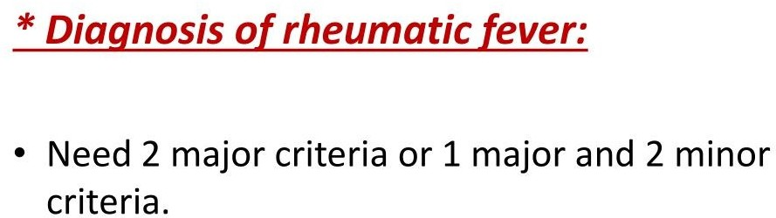

Slide 21
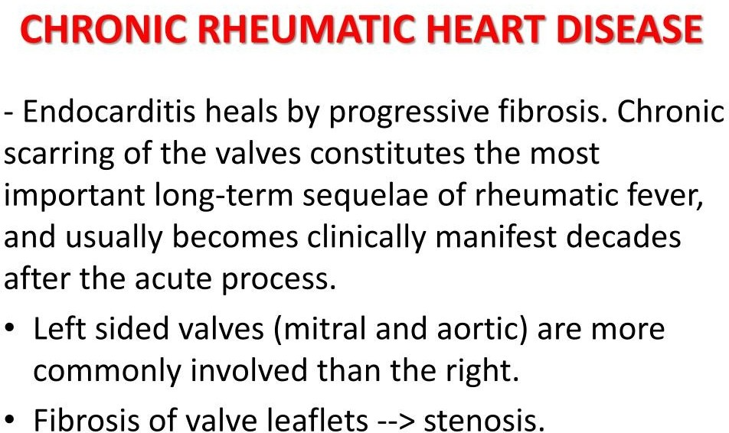

Slide 22
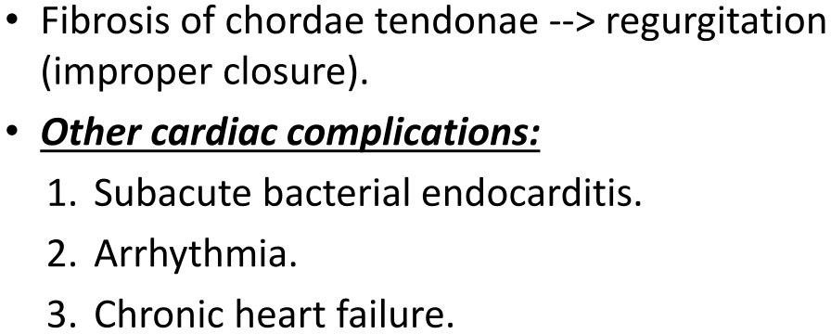

Slide 23
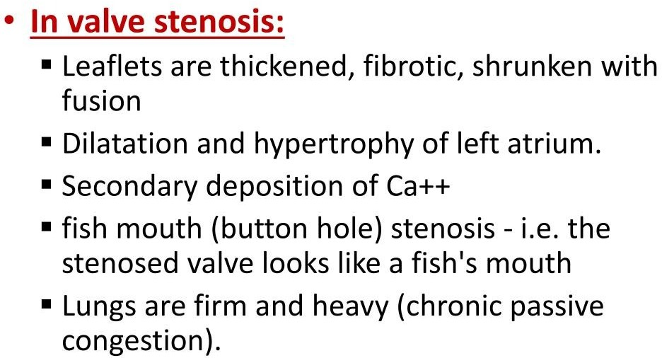

Slide 24
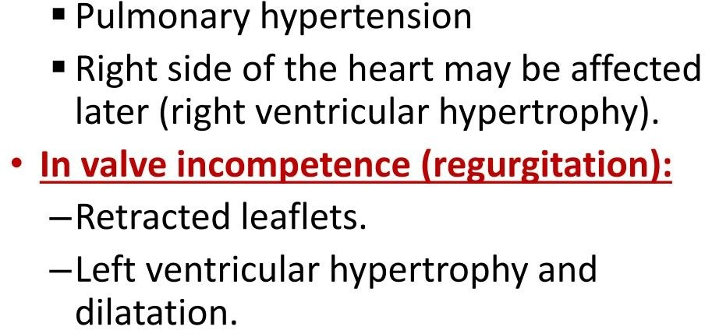

Slide 25
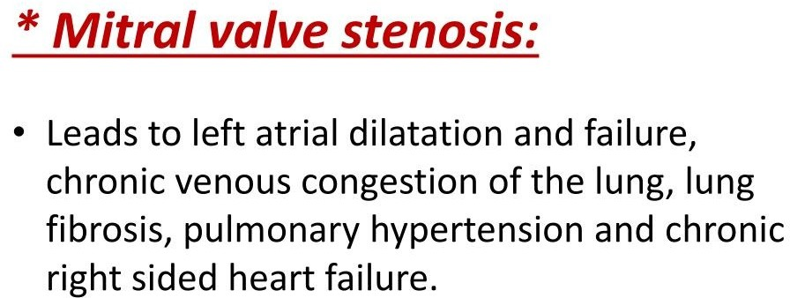

Slide 26
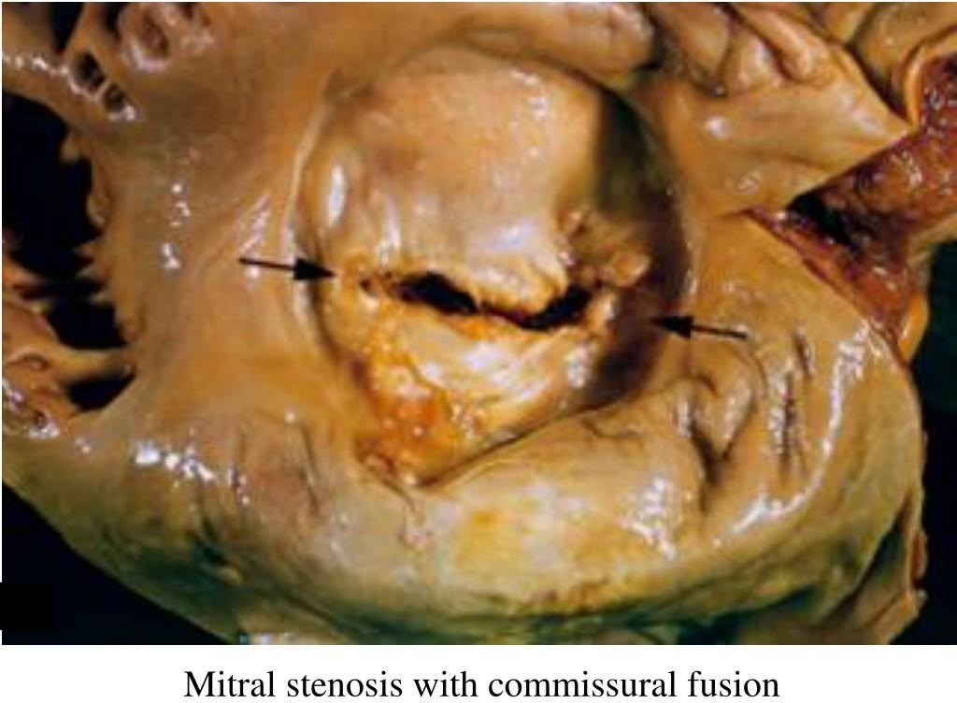

Slide 27
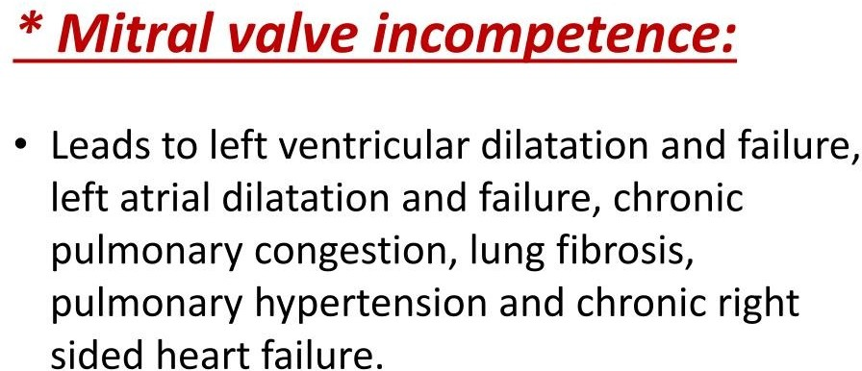

Slide 28


Slide 29
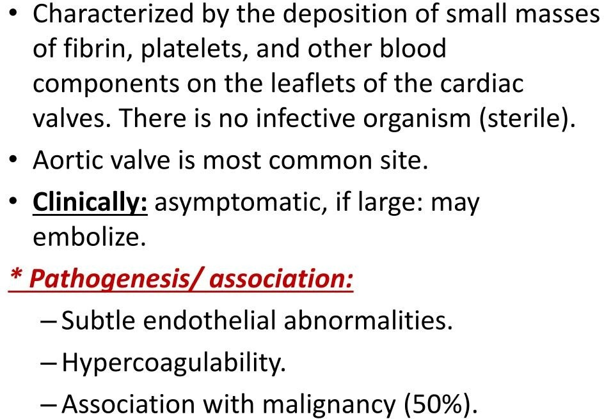

Slide 30


Slide 31
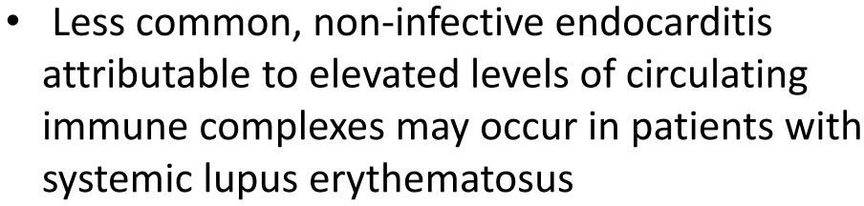

Slide 32
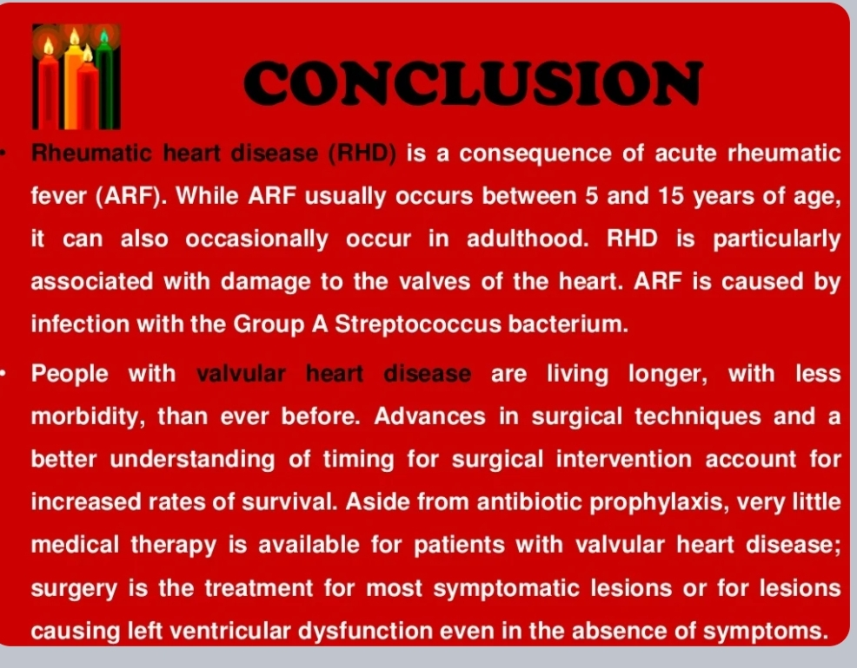

Slide 33
REFERENCES
DAVIDSON’S PRINCIPLES AND PRACTICE OF MEDICINE; 23rd edition
HARRISON’S PRINCIPLE OF INTERNAL MEDICINE; 21ST edition
TEXTBOOK OF CLINICAL MEDICINE by S.N Chugh ;5th edition

Slide 34
QUESTIONS AND ANSWERS

Slide 35
THANK YOU.....

